Slide 1

Hyper parameter tuning
Learning Objectives:
Master the process of hyperparameter tuning
Describe softmax classification for multiple classes
Apply batch normalization to make your neural network more robust
Build a neural network in TensorFlow and train it on a TensorFlow dataset
Describe the purpose and operation of GradientTape
Use tf.Variable to modify the state of a variable
Apply TensorFlow decorators to speed up code

Slide 2
Hyper parameter tuning
1 Tuning process
2 Using an appropriate scale to pick hyperparameters
3 Hyperparameters tuning in practice: Pandas vs Caviar
4 Normalizing activations in a network
5 Fitting Batch Norm into a neural network
6 Why does Batch Norm work?
7 Softmax regression
8 Deep Learning frameworks
9 TensorFlow

Slide 3
Hyperparameter tuning
Tuning process

Slide 4
Hyperparameters
Tuning these hyperparameters effectively can lead to a massive improvement in your position on the leaderboard. Following are a few common hyperparameters we frequently work with in a deep neural network:
Learning rate – α
Momentum – β
Adam’s hyperparameter – β1, β2, ε
Number of hidden layers
Number of hidden units for different layers
Learning rate decay
Mini-batch size
Learning rate usually proves to be the most important among the above. This is followed by the number of hidden units, momentum, mini-batch size, the number of hidden layers, and then the learning rate decay.

Slide 5
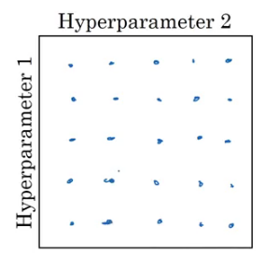
Hyperparameters
Now, suppose we have two hyperparameters. We sample the points in a grid and then systematically explore these values. Consider a five-by-five grid:
Notes:
Traditionally, hyperparameters were sampled on a grid, but in deep learning, it's recommended to sample hyperparameters randomly instead. This is because it's difficult to know in advance which hyperparameters are most important for a specific problem. Random sampling allows for a more rich exploration of a wide range of hyperparameters, which increases the likelihood of finding the best setting.
Another common practice in hyperparameter tuning is a coarse-to-fine sampling scheme. This involves starting with a coarse sampling of the hyperparameter space and then zooming in on promising regions for more dense sampling. This can help focus resources on the most promising areas of the hyperparameter space.
Random sampling and a coarse-to-fine sampling scheme is used to systematically organize the hyperparameter tuning process. The goal is to try out a wide range of values for each hyperparameter to find the best setting for the specific problem.

Slide 6
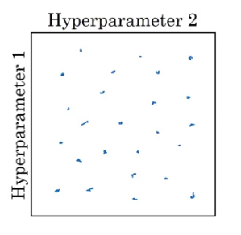
Hyperparameters
We check all 25 values and pick whichever hyperparameter works best. Instead of using these grids, we can try random values as well. Why? Because we do not know which hyperparameter value might turn out to be important, and in a grid we only define particular values.
The major takeaway from this sub-section is to use random sampling and adequate search.

Slide 7
Hyperparameter tuning
Using an appropriate scale to pick hyperparameters

Slide 8
Picking hyperparameters at random
While sampling at random can be a useful way to search for hyperparameters, it's not always the best approach. For example, if you're trying to select the number of hidden units for a given layer, sampling uniformly at random over a range of values may be appropriate.

Slide 9
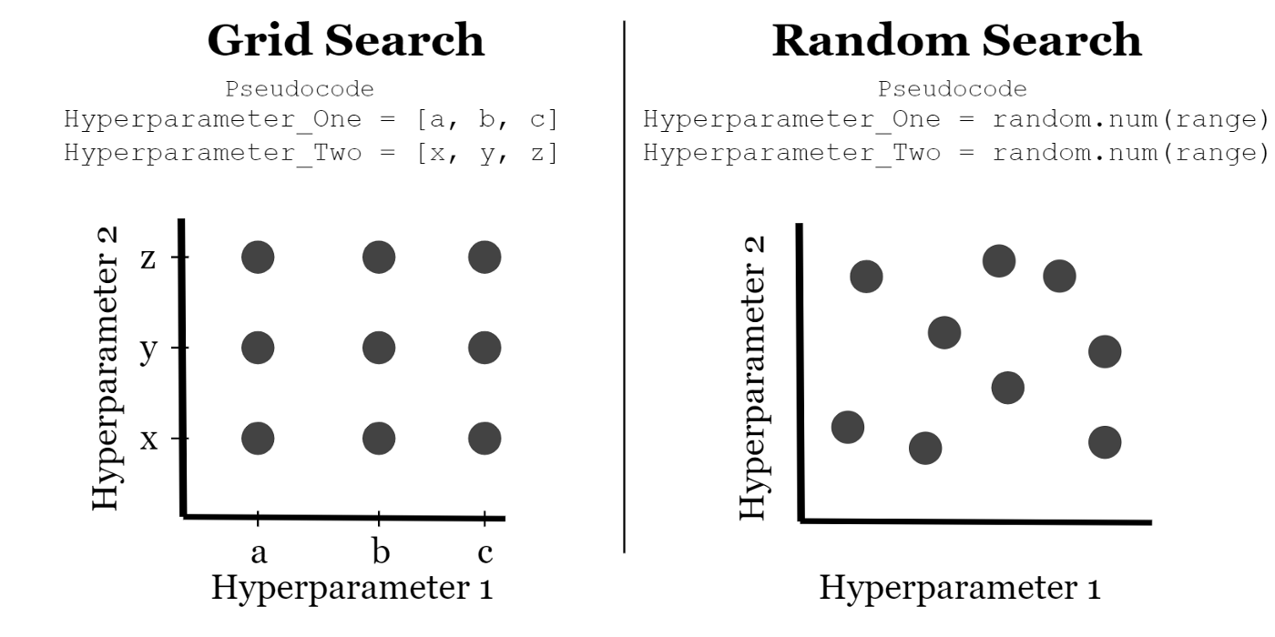
Picking hyperparameters at random

Slide 10
Appropriate scale for hyperparameters
Randomly selecting values from a uniform distribution might not be ideal for certain hyperparameters like learning rate (alpha) or beta in exponentially weighted averages.
For parameters like alpha, a more effective approach is to sample on a logarithmic scale, prioritizing the lower end where small changes can significantly impact results.
- To sample on a logarithmic scale in Python, you can use the formula alpha = 10 to the power of r, where r is a random number between -4 and 0.
Notes:
Choosing values randomly from a uniform distribution over a range might not be the most effective strategy for certain hyperparameters like the learning rate (alpha) or the beta hyperparameter utilized in calculating exponentially weighted averages..
When dealing with hyperparameters like alpha, it is more suitable to sample on a logarithmic scale. This allows for more resources to be dedicated to searching over the lower end of the range, where small changes in alpha can have a big impact on results.
- To sample on a logarithmic scale in Python, you can use the formula alpha = 10 to the power of r, where r is a random number between -4 and 0.

Slide 11
Appropriate scale for hyperparameters
For hyperparameters like beta, explore the range of values for 1 minus beta (0.1 to 0.001) by sampling uniformly at random. This approach allocates more resources to the range where small changes in beta have a significant impact.
While selecting the appropriate scale is crucial, note that even suboptimal scaling decisions can yield acceptable results.
A coarse-to-fine search is also effective, focusing on the most useful hyperparameter values in later iterations.
Notes:
For hyperparameters such as beta, it's best to explore the range of values for 1 minus beta, which ranges from 0.1 to 0.001, and sample uniformly at random over this range. This allows for more resources to be dedicated to exploring the range of values where small changes in beta can have a big impact on results.
While it's important to select the appropriate scale to explore hyperparameters, notes that even if you don't make the optimal scaling decision, you can still get okay results. Using a coarse to fine search can also be an effective way to focus on the most useful range of hyperparameter values in later iterations.
How to organize your hyperparameter search process to make it more efficient? (the next section)

Slide 12
Hyperparameters tuning
Hyperparameters tuning in practice Pandas vs Caviar

Slide 13
Hyperparameters tuning in practice Pandas vs Caviar
For efficient hyperparameter search in deep learning, consider that intuitions may not universally transfer across application areas. Cross-fertilization between domains is valuable, and exploring research papers from different areas can provide inspiration.
It's advisable to retest or reevaluate hyperparameters periodically, ensuring that the best settings remain optimal amid changes in data, algorithm development, or server upgrades.
Notes:
Some final tips and tricks for organizing the hyperparameter search process in deep learning. Intuitions about hyperparameter settings from one application area may or may not transfer to a different one. However, there is a lot of cross-fertilization among different domains, and people increasingly read research papers from other application domains to look for inspiration for cross-fertilization.
Retesting or reevaluating hyperparameters at least once every several months to make sure that the best setting of hyperparameters is not getting stale due to changes in data, algorithm development, or upgrades in servers.

Slide 14



Re-test hyperparameters occasionally
Idea
NLP, Vision, Speech, Ads, logistics, ….
Intuitions do get stale.
Re-evaluate occasionally.
Experiment
Code

Slide 15
Hyperparameters tuning in practice Pandas vs Caviar
For hyperparameter tuning, there are two main approaches: the "panda approach," where users carefully adjust a single model's learning rate, and the "caviar strategy," involving parallel training of multiple models with diverse hyperparameters to quickly identify the best-performing one.
The choice between these approaches depends on available computational resources.
Additionally, certain techniques can enhance neural network robustness to hyperparameter choices, simplifying the search process and accelerating training in applicable cases.
Notes:
One approach is the "panda approach," where people babysit one model gradually and patiently nudge the learning rate up or down, usually when there are limited computational resources.
The other approach is the "caviar strategy," where people train many models in parallel to try a lot of different hyperparameter settings and then quickly pick the one that works best. The choice between these two approaches depends on how much computational resources one has.
Another technique can make neural networks more robust to the choice of hyperparameters. This technique does not work for all neural networks, but when it does, it can make the hyperparameter search much easier and also make training go much faster. This technique will be introduced in the next section.

Slide 16
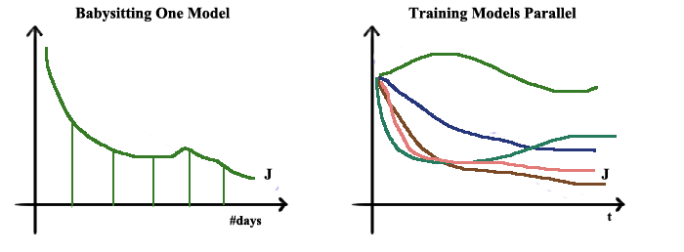

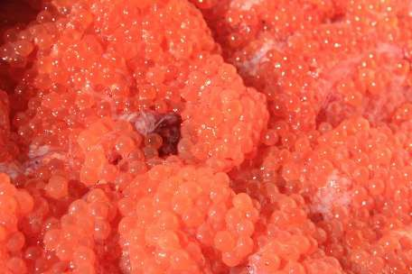
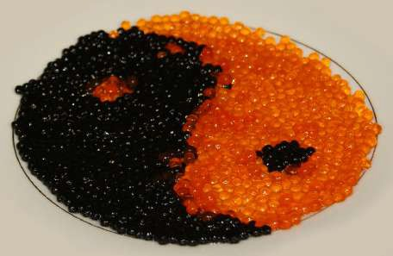
Babysitting one model
Training many models in parallel
Panda
Caviar

Slide 17
Batch Normalization
Normalizing
activations in a
network

Slide 18
Normalizing inputs to speed up learning
Batch normalization, developed by Sergey Ioffe and Christian Szegedy, normalizes mean and variance of hidden unit values in deep neural networks.
Similar to input feature normalization in logistic regression, batch normalization enhances the efficiency of training in networks with multiple hidden layers.
The process of batch normalization implementation involves computing mean and variance, followed by normalization. Learnable parameters, gamma and beta, are used to adjust mean and variance to desired values, preventing them from being fixed at 0 and 1.
Notes:
Batch normalization is an algorithm developed by researchers Sergey Ioffe and Christian Szegedy that is used to normalize the mean and variance of the hidden unit values in deep neural networks.
The idea is similar to how input features are normalized to speed up learning in logistic regression. However, in deep neural networks, you have multiple hidden layers, each with their own set of activations, so you want to normalize those activations to make the training of the network more efficient.
To implement batch normalization, you first compute the mean and variance of the hidden unit values, and then normalize them by subtracting off the mean and dividing by the standard deviation. This makes every component of the hidden unit have mean 0 and variance 1. However, you don't want the hidden units to always have mean 0 and variance 1, so you use learnable parameters gamma and beta to adjust the mean and variance to other values.

Slide 19
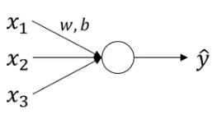
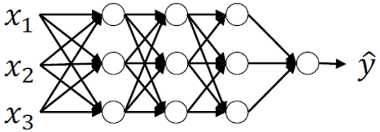
Normalizing inputs to speed up learning
Let’s recall how a logistic regression looks like:
We have seen how normalizing the input in this case can speed up the learning process. In case of deep neural networks, we have a lot of hidden layers and this results in a lot of activations:
Wouldn’t it be great if we can normalize the mean and variance of these activations (a[2]) in order to make the training of w[3], b[3] more effective?
a^{[1]}
a^{[2]}
w^{[3]} , b^{[3]}

Slide 20
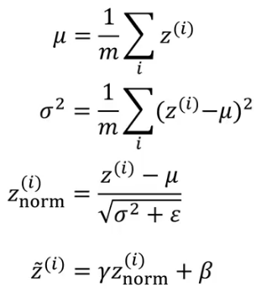
Normalizing inputs to speed up learning
This is how batch normalization works. We normalize the activations of the hidden layer(s) so that the weights of the next layer can be updated faster. Technically, we normalize the values of Z^{[2]} and then use an activation function of the normalized values. Here is how we can implement batch normalization:
Given some intermediate values in NN Z^{[1]},….,Z^{[m]}:
Here, Ɣ and β are learnable parameters.

Slide 21
Implementing Batch Norm
Gamma and beta in batch normalization allow you to customize the mean of normalized hidden unit values, providing flexibility in subsequent computations.
Batch normalization simplifies hyperparameter search, enhances neural network robustness, and facilitates training deep networks.
Notes:
The effect of gamma and beta is that they allow you to set the mean of the normalized hidden unit values to be whatever you want it to be. By appropriately setting gamma and beta, you can make the hidden unit values have other means and variances as well. So instead of using the original hidden unit values, you use the normalized hidden unit values with gamma and beta to perform subsequent computations in the neural network.
Batch normalization is useful because it makes hyperparameter search easier, makes neural networks more robust, and enables you to train even very deep networks.

Slide 22
Batch Normalization
Fitting Batch Norm into a neural network

Slide 23
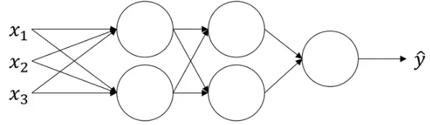


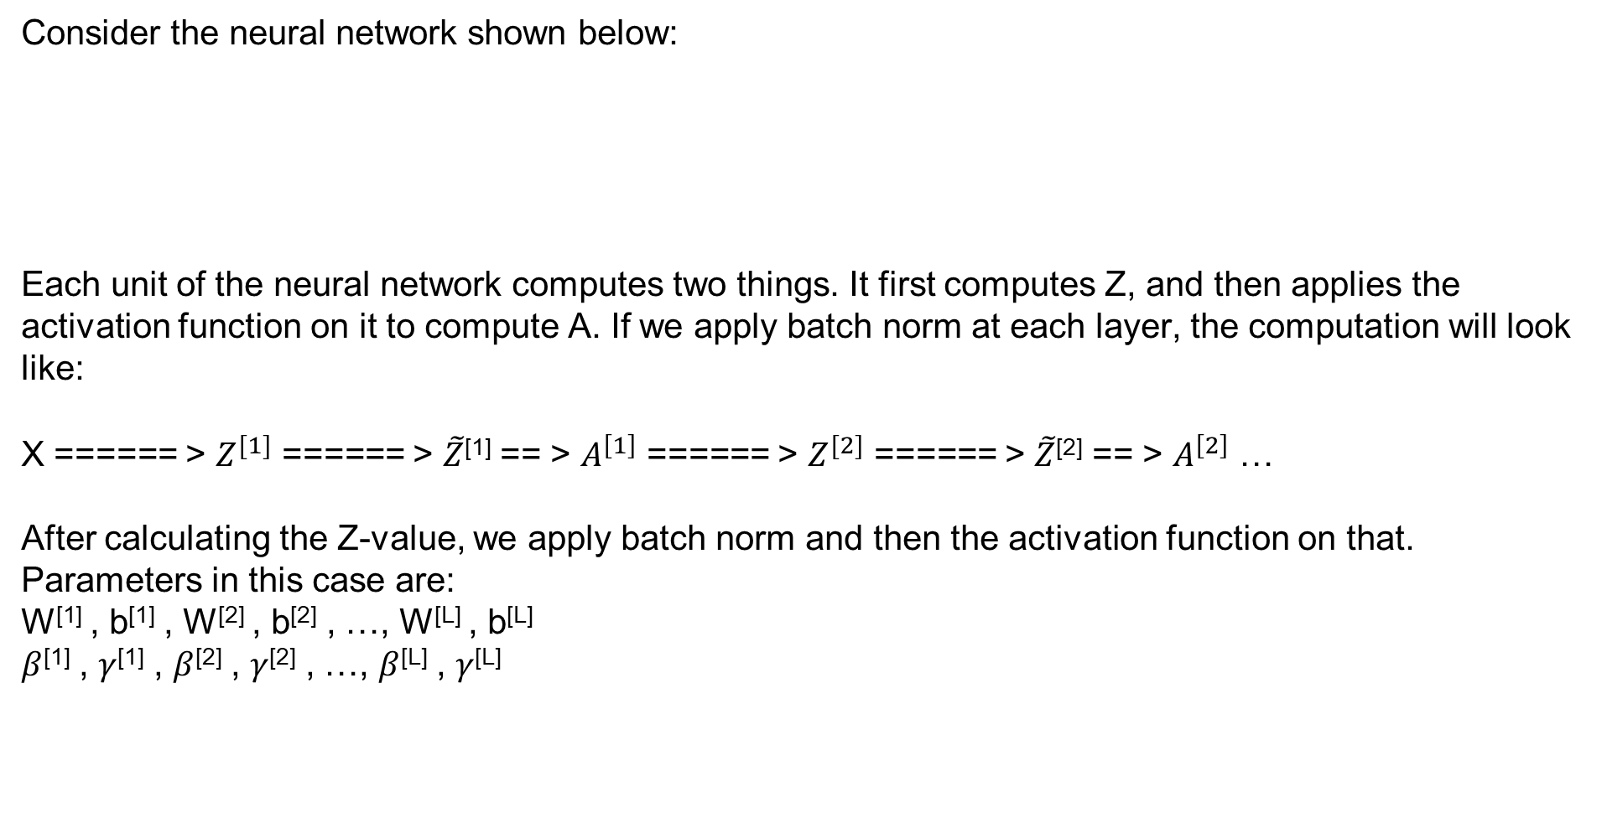
Adding Batch Norm to a network
Consider the neural network shown below:
Each unit of the neural network computes two things. It first computes Z, and then applies the activation function on it to compute A. If we apply batch norm at each layer, the computation will look like:
X ====== > $Z^{[1]}$ ====== > $\tilde{Z}$^{[1]} == > $A^{\left[1\right]}$ ====== > $Z^{[2]}$ ====== > $\tilde{Z}$^{[2]} == > $A^{\left[2\right]}$ …
After calculating the Z-value, we apply batch norm and then the activation function on that. Parameters in this case are:
W^{[1]} , b^{[1]} , W^{[2]} , b^{[2]} , …, W^{[L]} , b^{[L]}
$β$^{[1]} , $γ$^{[1]} , $β$^{[2]} , $γ$^{[2]} , …, $β$^{[L]} , $γ$^{[L]}
W^{[1]} , b^{[1]}
$β$^{[1]} , $γ$^{[1]}
W^{[2]} , b^{[2]}
$β$^{[2]} , $γ$^{[2]}
Batch norm
Batch norm

Slide 24
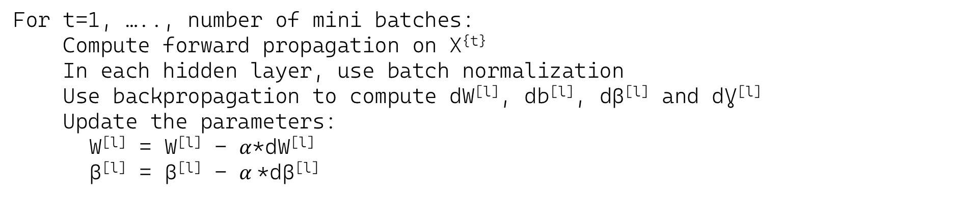
Implementing gradient descent
For t=1, ….., number of mini batches:
Compute forward propagation on X^{{t}}
In each hidden layer, use batch normalization
Use backpropagation to compute dW^{[l]}, db^{[l]}, dβ^{[l]} and dƔ^{[l]}
Update the parameters:
W^{[l]} = W^{[l]} - $α$*dW^{[l]}
β^{[l]} = β^{[l]} - $α$*dβ^{[l]}

Slide 25
Batch Normalization
Why does Batch Norm work?

Slide 26
Why does Batch Norm work?
The first reason is the same reason as why we normalize X.
The second reason is that batch normalization reduces the problem of input values changing (shifting).
Batch normalization does some regularization:
- Each mini batch is scaled by the mean/variance computed of that mini-batch.
- This adds some noise to the values Z^{[l]} within that mini batch. So similar to dropout it adds some noise to each hidden layer's activations.
- This has a slight regularization effect.
- Using bigger size of the mini-batch you are reducing noise and therefore regularization effect.
- Don't rely on batch normalization as a regularization. It's intended for normalization of hidden units, activations and therefore speeding up learning. For regularization use other regularization techniques (L2 or dropout).

Slide 27
Batch Norm as regularization
Each mini-batch is scaled by the mean/variance computed on just that mini-batch.
This adds some noise to the values Z^{[L]} within that minibatch. So similar to dropout, it adds some noise to each hidden layer’s activations.
This has a slight regularization effect.

Slide 28
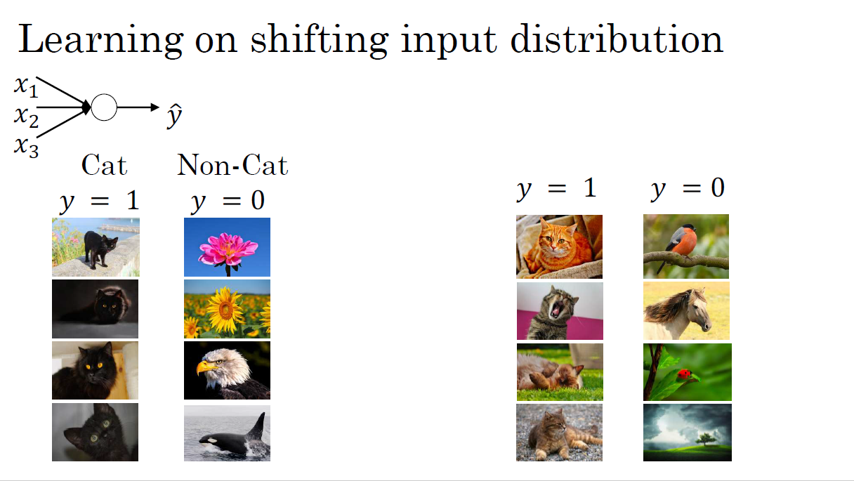

Slide 29
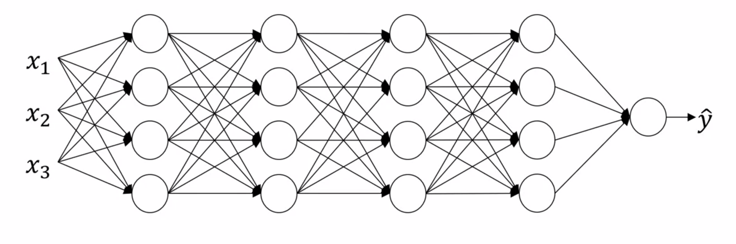




Why this is a problem with neural networks?
$$a_{1}^{\left[2\right]}$$
$$a_{2}^{\left[2\right]}$$
$$a_{3}^{\left[2\right]}$$
$$a_{4}^{\left[2\right]}$$

Slide 30
Multi-class classification
Softmax regression

Slide 31
Softmax regression
In multi-class classification, we deal with more than two classes, and softmax regression is employed to address such problems.
The output layer has units corresponding to the total number of classes, each indicating the probability of the input belonging to a specific class.
The Softmax layer transforms the linear output into probabilities by exponentiating and normalizing the values. This layer allows the representation of linear decision boundaries between multiple classes, and adding hidden layers enables the learning of complex non-linear decision boundaries.
Notes:
Binary classification means dealing with two classes. But when we have more than two classes in a problem, that is called multi-class classification. For example, instead of just recognizing cats, we want to recognize cats, dogs, and baby chicks. In this case, we have four possible classes, including an "other" or "none of the above" class.
For solving such problems, we use softmax regression. At the output layer, instead of having a single unit, we have units equal to the total number of classes (4 in the above case). Each unit tells us the probability of the image falling in different classes. Since it tells the probability, the sum of values from each unit is always equal to 1.
To compute this probability, we use a Softmax layer, which is an activation function that takes in the linear output of the final layer of the neural network, z^{[L]}, and computes a temporary variable, t, by exponentiating each element of z^{[L]} . Then, the output of the Softmax layer, a^{[L]} , is obtained by normalizing t such that the sum of the entries in a^{[L]} is 1.
The Softmax layer is unusual compared to other activation functions because it takes in a vector input and outputs a vector. However, it allows us to represent linear decision boundaries between multiple classes. In addition, by adding hidden layers to the neural network, we can learn even more complex non-linear decision boundaries to separate out multiple different classes.

Slide 32
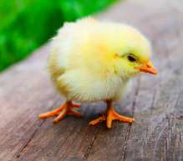


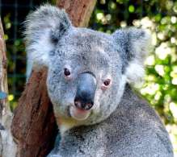
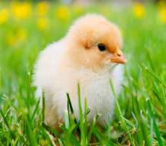



Recognizing cats, dogs, and baby chicks
Consider an example of the images and the classes they belong to. That's a picture of a baby chick, a cat, a dog and a koala (other).
3
1
2
0
3
2
0
1

Slide 33
Recognizing cats, dogs, and baby chicks
If we are classifying by classes ‘cat’, ‘dog’, ‘baby chick’ and ‘other’:
Cat class = 1
Dog class = 2
Baby chick class = 3
None class = 0
To represent a cat vector y = [0 1 0 0]
To represent a dog vector y = [0 0 1 0]
To represent a baby chick vector y = [0 0 0 1]
To represent a other vector y = [1 0 0 0]
Notations:
- C = no. of classes
- Range of classes is (0, ..., C-1)
- In output layer Ny = C

Slide 34
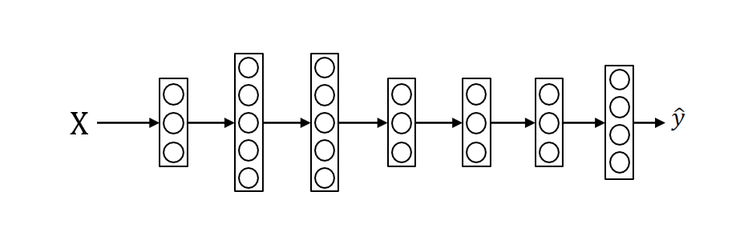
Recognizing cats, dogs, and baby chicks
3
1
2
0
3
2
0
1
P(other|x)
P(cat|x)
P(dog|x)
(4,1) vector
P(baby chick|x)
n^{[L]} = C = 4
Each of C values in the output layer will contain a probability of the example to belong to each of the classes.
In the last layer we will have to activate the Softmax activation function instead of the sigmoid activation.
Notes:
N, the number of units upper layer which is layer L is going to equal to 4 or in general this is going to equal to C. And what we want is for the number of units in the upper layer to tell us what is the probability of each of these four classes.
The first node is supposed to output the probability of the image having none of the below classes given input x.
The second node is supposed to output the probability that the image is of a cat given the input x.
The third node will output probability that image is a dog.
The fourth node will output the probability that image contains a baby chick given the input x.
The output labels ŷ (y hat) is going to be a four by one dimensional vector, because it now has to output four numbers, giving you these four probabilities.

Slide 35
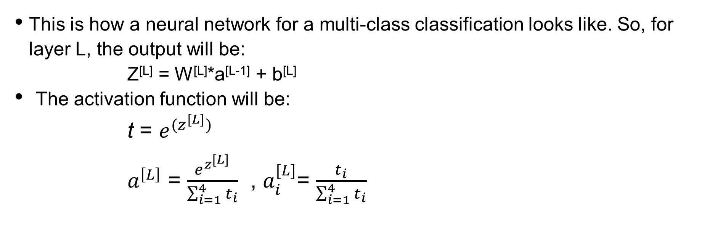
Recognizing cats, dogs, and baby chicks
This is how a neural network for a multi-class classification looks like. So, for layer L, the output will be:
Z^{[L]} = W^{[L]}*a^{[L-1]} + b^{[L]}
The activation function will be:
t = $e^{(z^{[L]})}$
$a^{\left[L\right]}$ = $\frac{e^{z^{[L]}}}{\sum_{i=1}^{4}{t_{i}}}$ , $a_{i}^{[L]}$= $\frac{t_{i}}{\sum_{i=1}^{4}{t_{i}}}$
Notes:
Because probabilities should sum to one, the four numbers in the output ŷ (y hat), they should sum to one.
The standard model for getting your network to do this uses what's called a Softmax layer, and the output layer in order to generate these outputs.
In the final layer of the neural network, you are going to compute as usual the linear part of the layers. So Z^{[L]} , that's the z variable for the final layer.
So remember this last layer of the neural network is layer capital L. So as usual you compute that as Z^{[L]} =W^{[L]} TA^{[L-1]} +b^{[L]} which i weights of the layer times the activation of the previous layer plus the biases for that final layer.
Now having computed Z^{[L]} , you now need to apply what's called the Softmax activation function.
So that activation function is a bit unusual for the Softmax layer, but this is what it does.

Slide 36
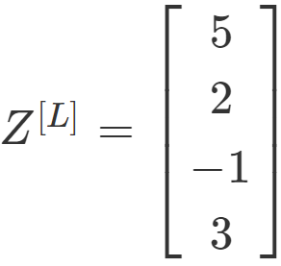
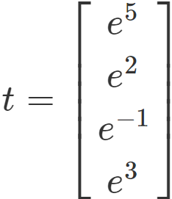
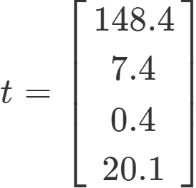

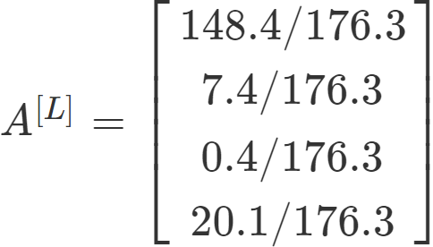
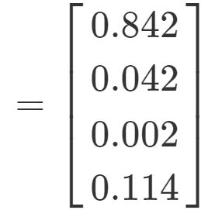
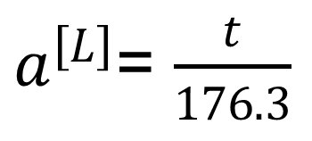
Recognizing cats, dogs, and baby chicks
Let’s say that Z^{[L]} is a four dimensional vector 5, 2, -1, 3
==>
==>
==>
$a^{\left[L\right]}$= $\frac{t}{176.3}$
==>
==>

Slide 37
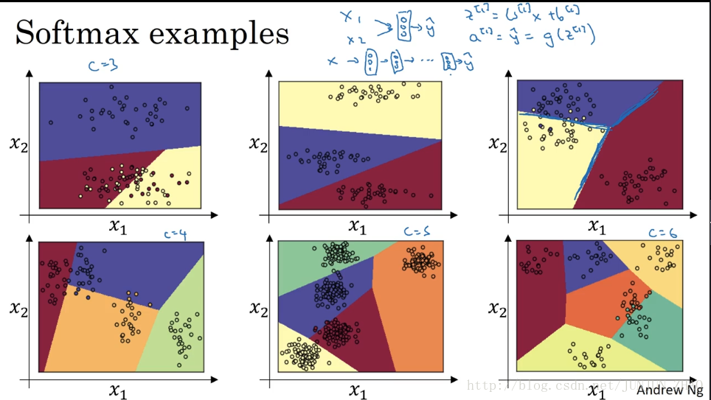

Slide 38
Softmax examples
Let's look at the plot some examples with more classes. So it's an example with C equals 4, so that the green class and Softmax can continue to represent these types of linear decision boundaries between multiple classes. So here's one more example with C equals 5 classes, and here's one in the plot above last example with C equals 6.
So the plot shows the type of things the Softmax classifier can do when there is no hidden layer of class, even much deeper neural network with x and then some hidden units, and then more hidden units, and so on. Then you can learn even more complex non-linear decision boundaries to separate out multiple different classes.

Slide 39
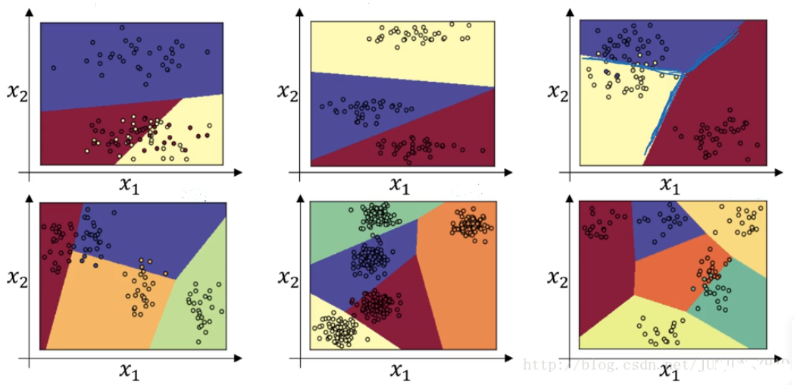
Softmax examples
C = 3
C = 3
C = 3
C = 4
C = 5
C = 6
Notes:
The color on the previous plot shows fresh holding the upward of the Softmax classifier, and coloring in the input base on which one of the three outputs have the highest probability.
So we can maybe we kind of see that this is like a generalization of logistic regression with sort of linear decision boundaries, but with more than two classes class 0, 1, the class could be 0, 1, or 2. Here's another example of the decision boundary that a Softmax classifier represents when three normal datasets with three classes.
The plot has intuition that the decision boundary between any two classes will be more linear. That's why you see for example that decision boundary between the yellow and the various classes, that's the linear boundary where the purple and red linear in boundary between the purple and yellow and other linear decision boundary. But able to use these different linear functions in order to separate the space into three classes.

Slide 40
Multi-class classification
Training a Softmax Classifier

Slide 41
Training a Softmax Classifier
In binary classification, we have two possible labels, either 0 or 1, and we are trying to recognize one of two classes. However, in multiclass classification, we have multiple possible classes, and we want to recognize one of C classes. For example, instead of just recognizing cats, we want to recognize cats, dogs, and baby chicks. In this case, we have four possible classes, including an "other" or "none of the above" class.
To implement this, we need to build a new neural network with an upper layer that has C units, where C is the number of classes we want to categorize the inputs into. The output labels, represented as y hat, will be a C by 1 dimensional vector that outputs the probability of each of the C classes.
Notes:
In binary classification, we have two possible labels, either 0 or 1, and we are trying to recognize one of two classes. However, in multiclass classification, we have multiple possible classes, and we want to recognize one of C classes. For example, instead of just recognizing cats, we want to recognize cats, dogs, and baby chicks. In this case, we have four possible classes, including an "other" or "none of the above" class.
To implement this, we need to build a new neural network with an upper layer that has C units, where C is the number of classes we want to categorize the inputs into. The output labels, represented as y hat, will be a C by 1 dimensional vector that outputs the probability of each of the C classes.

Slide 42
Programming Frameworks
Deep Learning frameworks

Slide 43
Deep learning frameworks
Caffe/Caffe2
CNTK
DL4J
Keras
Lasagne
mxnet
PaddlePaddle
TensorFlow
Theano
Torch
Choosing deep learning frameworks
Ease of programming (development and deployment)
Running speed
Truly open (open source with good governance)

Slide 44
Programming Frameworks
TensorFlow

Slide 45
TensorFlow
TensorFlow is an open-source machine learning library developed by the Google Brain team. It is one of the most popular and widely used frameworks for building and deploying machine learning models. TensorFlow provides a comprehensive ecosystem of tools, libraries, and community resources that make it suitable for a range of applications, from research to production deployment.
TensorFlow is a deep learning programming framework that can help developers be more efficient in implementing and using deep learning algorithms.

Slide 46
TensorFlow
Key features of TensorFlow include:
Flexible Architecture: TensorFlow allows you to deploy computation to one or more CPUs or GPUs in a desktop, server, or mobile device with a single API. It supports both CPU and GPU acceleration, making it suitable for a wide range of hardware configurations.
High-Level APIs: TensorFlow provides high-level APIs like Keras, which simplifies the process of building and training neural networks. Keras is now integrated as the official high-level API of TensorFlow, making it user-friendly and accessible to beginners while maintaining the flexibility needed by researchers and experts.
Scalability: TensorFlow is designed to scale from single machines to large clusters of GPUs and TPUs (Tensor Processing Units). This makes it suitable for both small-scale and large-scale machine learning applications.
Community and Documentation: TensorFlow has a large and active community of developers, researchers, and practitioners. This means there are plenty of resources, tutorials, and documentation available for users at all levels of expertise.

Slide 47
TensorFlow
TensorBoard: TensorFlow comes with a visualization tool called TensorBoard, which allows you to visualize and debug your machine learning models. You can monitor metrics, visualize the graph of your model, and explore the learning process in real-time.
Support for Various Platforms: TensorFlow supports a variety of platforms, including desktops, servers, and mobile devices. This versatility makes it easy to deploy models across different environments.
Support for Different Types of Models: While TensorFlow is widely used for deep learning, it also supports other machine learning paradigms such as reinforcement learning, natural language processing, and more.
Extensibility: TensorFlow is highly extensible and allows users to add custom functionality through the use of extensions and custom operators.

Slide 48
TensorFlow
Lets see how to implement a minimization function:
J(w) = w² - 10w + 25 = (w - 5)²
(cost)
The result should be w = 5 as the function is (w - 5)² = 0

Slide 49
TensorFlow
Code version 1:
import numpy as np
import tensorflow as tf
w = tf.Variable(0, dtype=tf.float32) # creating a variable w
cost = tf.add(tf.add(w**2, tf.multiply(-10.0, w)), 25.0) # can be written as this - # cost = w**2 - 10*w + 25
train = tf.train.GradientDescentOptimizer(0.01).minimize(cost)
init = tf.global_variables_initializer()
session = tf.Session()
session.run(init)
session.run(w) # Runs the definition of w, if you print this it will print zero session.run(train)
print("W after one iteration:", session.run(w))
for i in range(1000):
session.run(train)
print("W after 1000 iterations:", session.run(w))

Slide 50
TensorFlow
Code version 2:
import numpy as np
import tensorflow as tf
coefficients = np.array([[1.], [-10.], [25.]])
x = tf.placeholder(tf.float32, [3, 1])
w = tf.Variable(0, dtype=tf.float32) # Creating a variable w
cost = x[0][0]*w**2 + x[1][0]*w + x[2][0]
train = tf.train.GradientDescentOptimizer(0.01).minimize(cost)
init = tf.global_variables_initializer()
session = tf.Session()
session.run(init)
session.run(w) # Runs the definition of w, if you print this it will print zero session.run(train, feed_dict={x: coefficients})
print("W after one iteration:", session.run(w))
for i in range(1000):
session.run(train, feed_dict={x: coefficients})
print("W after 1000 iterations:", session.run(w))

Slide 51
TensorFlow
In TensorFlow you implement only the forward propagation and TensorFlow will do the backpropagation by itself.
In TensorFlow a placeholder is a variable you can assign a value to later.
If you are using a mini-batch training you should change the feed_dict={x: coefficients} to the current mini-batch data.
Almost all TensorFlow programs use this:
tf.Session() as session:# better for cleaning up in # case of error/exception
session.run(init)
session.run(w)
In deep learning frameworks there are a lot of things that you can do with one line of code like changing the optimizer.

Slide 52
TensorFlow
In deep learning frameworks, tasks like changing the optimizer can often be achieved with a single line of code.
TensorFlow programming involves creating Tensors, performing operations on them, initializing, creating a session, and running it to execute the operations.
Notes:
In deep learning frameworks there are a lot of things that you can do with one line of code like changing the optimizer.
Writing and running programs in TensorFlow has the following steps:
1. Create Tensors (variables) that are not yet executed/evaluated.
2. Write operations between those Tensors.
3. Initialize your Tensors.
4. Create a Session.
5. Run the Session. This will run the operations you'd written above.

Slide 53
TensorFlow
We can use this line to compute the cost function: tf.nn.sigmoid_cross_entropy_with_logits(logits = ..., labels = ...)
To initialize weights in NN using TensorFlow use:
W1 = tf.get_variable("W1", [25,12288], initializer = tf.contrib.layers.xavier_initializer(seed = 1))
b1 = tf.get_variable("b1", [25,1], initializer = tf.zeros_initializer())
For 3-layer NN, it is important to note that the forward propagation stops at Z^{[3]}. The reason is that in TensorFlow the last linear layer output is given as input to the function computing the loss. Therefore, you don't need A^{[3]} !
To reset the graph use tf.reset_default_graph()

Slide 54
Summarization
Tuning involves iteratively adjusting hyperparameters and model aspects for optimal performance.
Hyperparameters should be explored on a logarithmic scale for efficient tuning. "Pandas" (random search) and "Caviar" (Bayesian optimization) are compared for hyperparameter tuning, with Caviar often yielding better results.
Activation normalization stabilizes learning by ensuring consistent distributions of neuron activations.
Batch Normalization (Batch Norm) normalizes layer inputs, enhancing training stability, convergence, and generalization. Batch Norm addresses internal covariate shift, allowing higher learning rates.
Softmax regression is used for multiclass classification, assigning probabilities to each class.
Deep learning frameworks like TensorFlow provide tools for building, training, and deploying neural networks. TensorFlow, developed by Google, offers a flexible ecosystem for various neural network architectures.
Notes:
Tuning Process:
- The iterative process of adjusting hyperparameters, architecture, and other aspects of a model to optimize its performance on a given task.
Using an Appropriate Scale to Pick Hyperparameters:
- Hyperparameters should be searched over appropriate ranges to ensure effective tuning. - Using a logarithmic scale can help explore a wide range efficiently.
Hyperparameters Tuning in Practice: Pandas vs. Caviar:
- Compares two approaches to hyperparameter tuning: "Pandas" (random search) and "Caviar" (Bayesian optimization). Caviar often leads to better results but requires more computational resources.
Normalizing Activations in a Network:
- Activation normalization aims to stabilize learning by ensuring consistent distributions of neuron activations across layers
Fitting Batch Norm into a Neural Network:
- Batch Normalization (Batch Norm) is a technique that normalizes layer inputs within mini- batches, improving training stability, convergence speed, and generalization.
Why Does Batch Norm Work?
- Batch Norm addresses internal covariate shift, stabilizing learning dynamics by reducing the influence of vanishing/exploding gradients and allowing higher learning rates.
Softmax Regression:
- Softmax regression, also called multinomial logistic regression, is used for multiclass classification. It assigns probabilities to each class and selects the class with the highest probability.
Deep Learning Frameworks:
- Deep learning frameworks provide tools and libraries for building, training, and deploying neural network models.
TensorFlow:
- TensorFlow is an open-source deep learning framework developed by Google. It offers a flexible ecosystem for building and training various types of neural network architectures.

